Slide 1
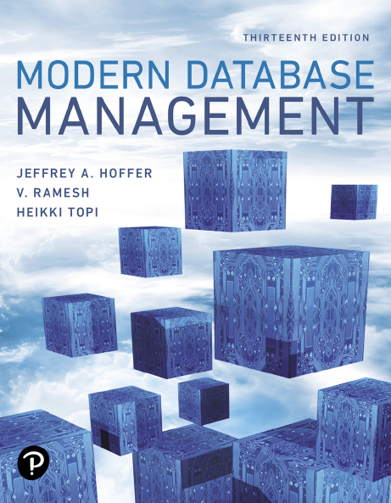
Modern Database Management
Thirteenth Edition
Chapter 7
Databases in Applications
Copyright © 2019, 2016, 2013 Pearson Education, Inc. All Rights Reserved
Notes:
If this PowerPoint presentation contains mathematical equations, you may need to check that your computer has the following installed:
1) MathType Plugin
2) Math Player (free versions available)
3) NVDA Reader (free versions available)

Slide 2
Learning Objectives
7.1 Define terms
7.2 Explain three components of client/server systems: presentation, processing, and storage
7.3 Distinguish between two-tier and three-tier architectures
7.4 Describe key components and information flow in Web applications
7.5 Describe how to connect to databases in 3-tier applications using Java (J S P) and Python
7.6 Understand the notion of transaction integrity
7.7 Compare optimistic and pessimistic concurrency control
7.8 Understand the basics of application security

Slide 3
Client/Server Architectures
Networked computing model
Processes distributed between clients and servers
Client – Workstation (P C, smartphone, tablet) that requests and uses a service
Server – Powerful computer (P C/mini/mainframe) that provides a service
For D B M S, server is a database server
For the Internet, server is a Web server
Notes:
Client/server applications began with the advent of networked computing, and are the dominant paradigm for computing applications for the past 25 years. Prior to that, mainframe computers with “dumb terminals” (and later “smart terminals”) was the dominant mode. These still exist, but they are usually also somehow connected C/S networks.
Every time you use the Web you are operating in a client/server environment. The idea is that the client requests some sort of resource, and the server provides it. Each server will service many clients, maybe even millions (for example Amazon’s Web servers).
Servers can be file servers, print servers, database servers, Web servers, or in general servers providing any shared resource to clients in the network. For example, your school’s computer lab has a shared printer that you can use, and this is done by a print server in a client/server environment. The computer you work on is a client in that network. This is typically called a local area network (LAN).
Web servers operate in the Internet, which is a wide area network (WAN).
Advances in personal computing, smartphone, and tablet technology and the corresponding rapid evolution of graphical user interfaces (GUIs), networking, and communications have changed the way businesses use computing systems to meet ever more demanding business needs. Electronic commerce requires that clients (PCs or smartphones) be able to access dynamic Web pages attached to databases that provide real-time information. Mainframe applications have been rewritten to run in client/server environments and take advantage of the greater cost-effectiveness of advances in networking, personal computers, smartphones, and tablets.

Slide 4
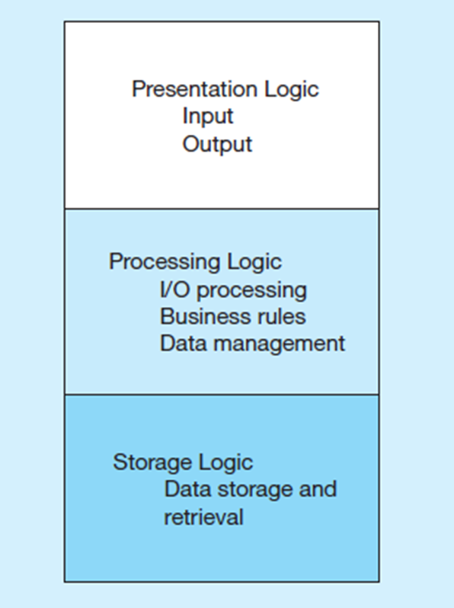
Figure 7-1 Application Logic Components
G U I interface (e.g. through a browser)
Procedures, functions, programs
D B M S activities
Notes:
As you can see here, there are three main layers in an application, and they serve different purposes. The presentation layer is what you the user directly interact with. The processing logic involves the software doing all the computation for the application. And the storage logic involves the activities of the DBMS. Different types of C/S systems will distribute these three in different ways.

Slide 5
Application Partitioning
Placing portions of the application code in different locations (client versus. server) after it is written
Advantages
Improved performance
Improved interoperability
Balanced workloads
Notes:
We’re going to see different types of application partitioning. This involves distributing the presentation, processing, and storage logic to different computers in the client server network. Of course, presentation is always at the client.

Slide 6
Fat versus. Thin Clients
Fat client – a client P C that is responsible for processing presentation logic, extensive application and business rules logic, and many D B M S functions
Thin client – an application where the client (P C) accessing the application primarily provides the user interfaces and some application processing, usually with no or limited local data storage

Slide 7
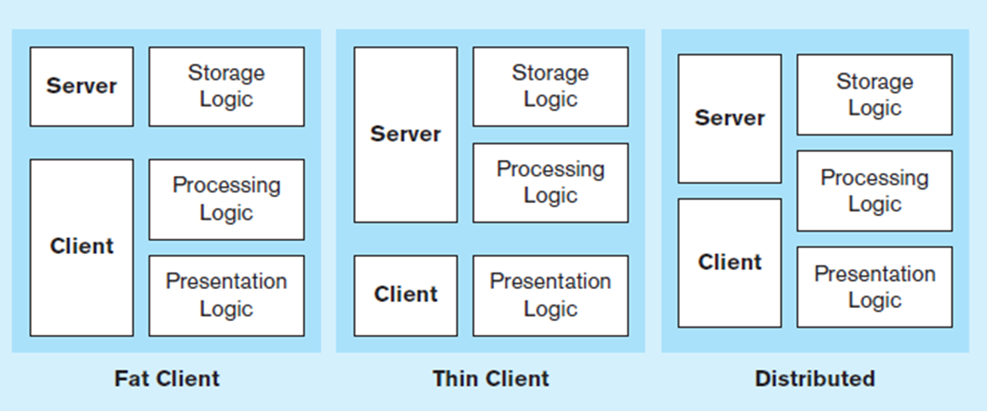
Figure 7-2 Common Logic Distributions (1 of 2)
a) Two-tier client-server environments
Processing logic could be at client (fat client), server (thin client), or both (distributed environment).
Notes:
Local area networks are typically implemented as a 2-tier system. Here, the presentation layer always does presentation logic, and the server always does storage logic. Processing logic could take place in either. This is what you are using when you work within an office’s local network, or your school’s computer labs.

Slide 8
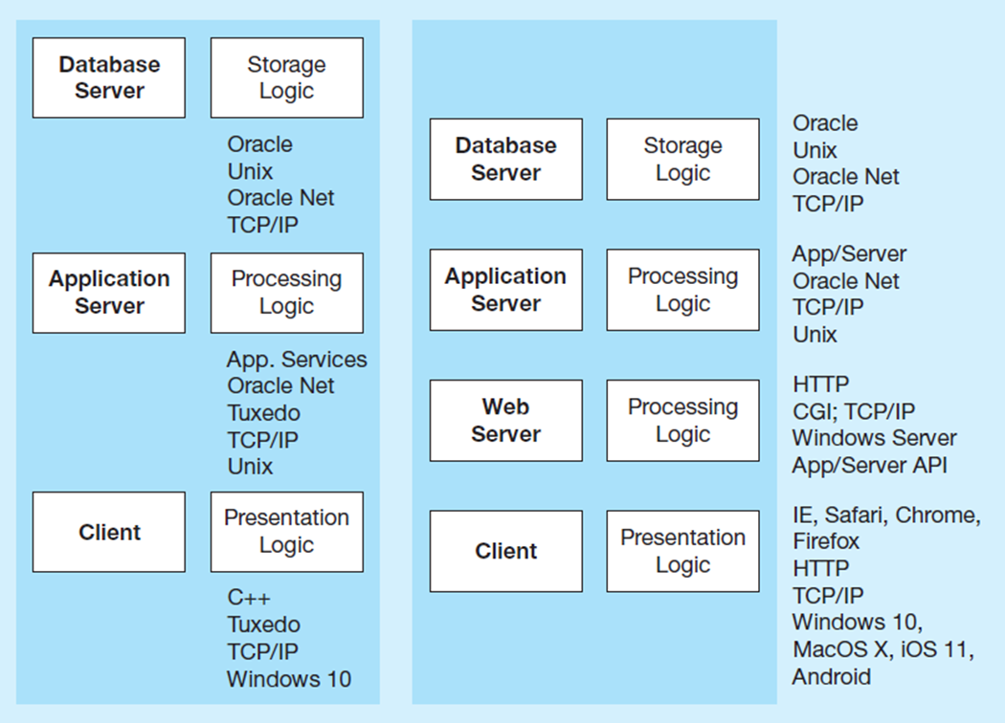
Figure 7-2 Common Logic Distributions (2 of 2)
b) Three-tier and n-tier client-server environments
Processing logic will be at application server or Web server.
Notes:
This is how it’s done on the Web. There are at least three tiers, with each tier doing one of the three logics. The client is you on your PC or mobile device. Application logic takes place on the application server and the DBMS is on the database server. We’ll see in later slides some code you’ll typically see in application logic.
Notice that sometimes the processing logic is split. The underlying business logic is done on one server and the control of Internet processing is done on the Web server.

Slide 9
Web Application Components
Database server – hosts the D B M S
e.g., Oracle, S Q L Server, Informix, M S Access, My S q l
Web server – receives and responds to browser requests using H T T P protocol
e.g., Apache, Internet Information Services (I I S)
Application server – software building blocks for creating dynamic Web sites
e.g., M S A S P.NET framework, Java E E, P H P
Web browser – client program that sends Web requests and receives Web pages
e.g., Internet Explorer, Mozilla Firefox, Apple Safari, Google Chrome

Slide 10
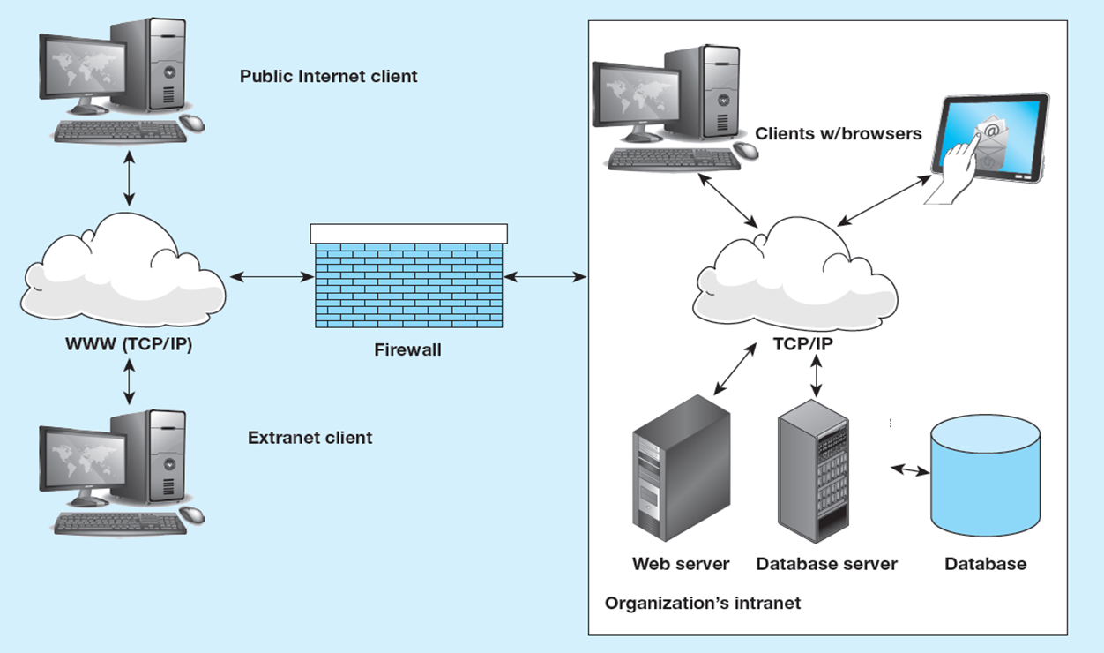
Figure 7-3 A Database-Enabled Intranet/Internet Environment
Notes:
The network protocol for Internet-bound traffic is TCP/IP, which stands for Transmission Control Protocol – Internet Protocol. The notion of an extranet is what we usually think of when we use a Web site like Amazon. Companies interact with the public via extranets. An intranet also uses 3-tier internet technology (Web servers, TCP/IP protocol) but is limited to access from within an organizations control. This is hidden from the external internet by a firewall, providing security for the organization’s resources.

Slide 11
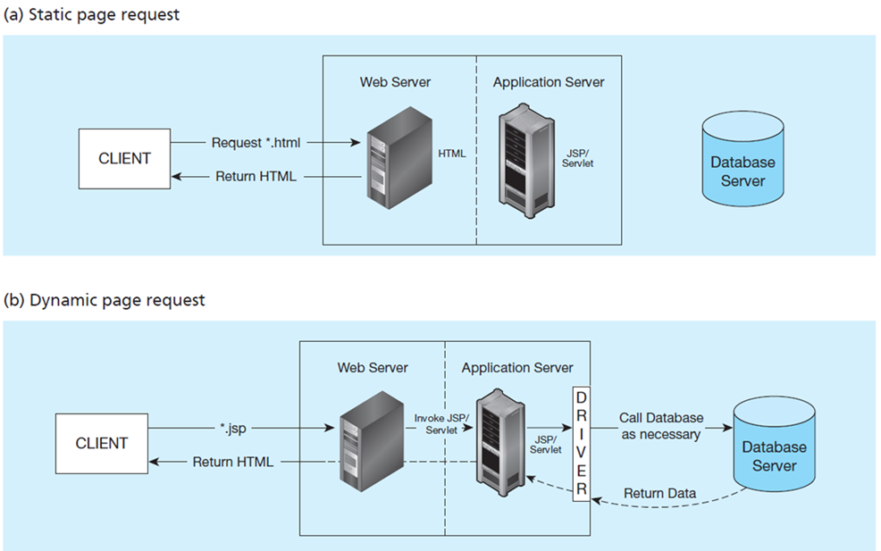
Figure 7-5 Information Flow in a Three-Tier Architecture
(a) Has no server side processing, just a page return
(b) Has server side processing, including database access
Notes:
This shows the difference between static and dynamic page requests. Any Web request to a .html or .shtml file is a static request. No application processing takes place on the application server. Basically, the file retrieved has all the HTML, CSS, and JavaScript code in it.
URLs with .jsp, .php, and .aspx are dynamic page requests. Here, the application server is invoked and interacts with the database to dynamically generate the HTML, CSS, and JavaScript that gets sent to the browser.

Slide 12
Middleware and A P Is
Middleware – software that allows an application to interoperate with other software without requiring user to understand and code low-level operations
Application Program Interface (A P I) – routines that an application uses to direct the performance of procedures by the computer’s operating system
Common database A P Is – O D B C, A D O .N E T, J D B C
Notes:
No matter what C/S architecture you use, you will encounter middleware and APIs. There are many kinds of APIs, and database APIs are only one type. For example, there are API’s for the presentation layer stuff (forms, buttons, list boxes, and all the user interface processing). There are also APIs for working with different Web services; often these are in the form of REST and XML.
Computer programmers and application developers will use APIs for interacting with the database, and these APIs invoke middleware to provide the connection to the DBMS.
ODBC and ADO .NET are the most common database APIs for the Microsoft platform. ODBC is older, and ADO .NET is more modern. ADO .NET is the most common database API in Web applications.

Slide 13
Steps for Using Databases via Middleware A P Is
Identify and register a database driver.
Open a connection to a database.
Execute a query against the database.
Process the results of the query.
Repeat steps 3–4 as necessary.
Close the connection to the database.
Notes:
When you’re writing a program that interacts with a database, you will need to do all these things in the code. Different programming languages have different syntax and we’ll see a couple examples.

Slide 14
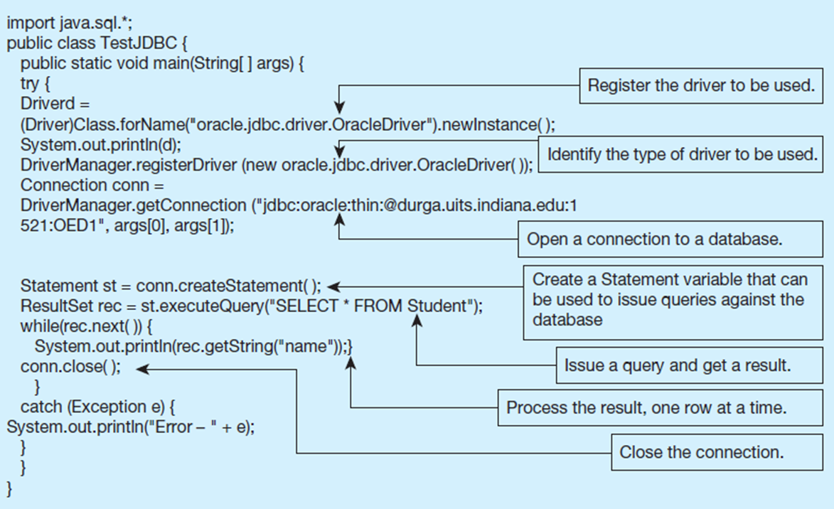
Figure 7-7 Database Access from a Java Program
Java implementation of database access to an Oracle database using J D B C
Notes:
Here’s the Java code for doing the steps from the previous slide. The “driver” is the middleware program that provides the link to the DBMS. At the “open a connection” step you can see the connection string. And further down, you see the query. The data returned from the query is in a “result set”, and your program can loop through this result set to obtain that data.
The JDBC classes that you will likely use in a Java database program are Driver, DriverManager, Connection, Statement, and ResultSet. Each of these are classes in the Java JDBC API.

Slide 15
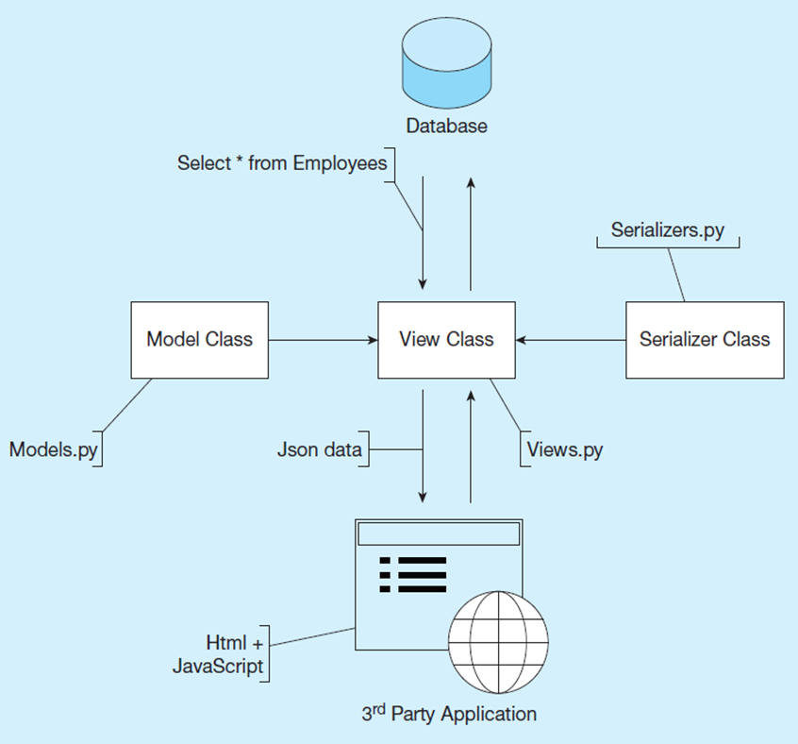
Figure 7-8 System Architecture of Sample Application
Python application for database processing.
Model class creates instances of data from table queries.
Serializer class transforms database data into a form that can be used by the client (J S O N).
View classes display in browsers for view or edit.
Notes:
The textbook shows a Python application that involves a database server, various Python classes executing on an application server, and output to a Web client.
JavaScript Object Notation (JSON) is a data-interchange format that is both easy for humans to read and for machines to parse and generate.

Slide 16

Copyright

